Slide 1
Lesson 6 - Removing an Element From an Array
Mr Mack 2019

Slide 2
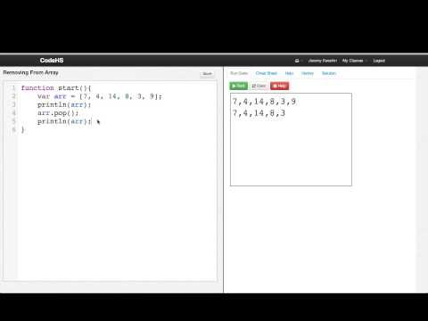
Removing an Element From an Array

Slide 3
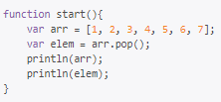
What is the output of the following program?
[1, 2, 3, 4, 5, 6]
[7]
[1, 2, 3, 4, 5, 6]
7
[2, 3, 4, 5, 6, 7]
1
[2, 3, 4, 5, 6, 7]
[1]

Slide 4

What is the output of the following program?
[1, 2, 3, 4, 5]
[3, 4, 5, 6, 7]
[1, 3, 4, 5, 6, 7]
[1, 2, 4, 5, 6, 7]

Slide 5
Example: Splice and Remove
This is an example for this lesson. You are encouraged to play around with it, run and change the code, and learn how it works. When you are done, click continue to go to the next problem.

Slide 6
Exercise 5.6.1: Remove From Line
You are given an array of names of people who are in line for movie tickets. Use the remove element
to remove the first person from the line twice, as if you have just given them their tickets.
var line = ["Sam", "Lisa", "Laurie", "Bob", "Ryan"];
You should write a function to print everyone in line. Then print the line before and after removing the people.
The console should print this:
Sam, Lisa, Laurie, Bob, Ryan
Laurie, Bob, Ryan

